Slide 1
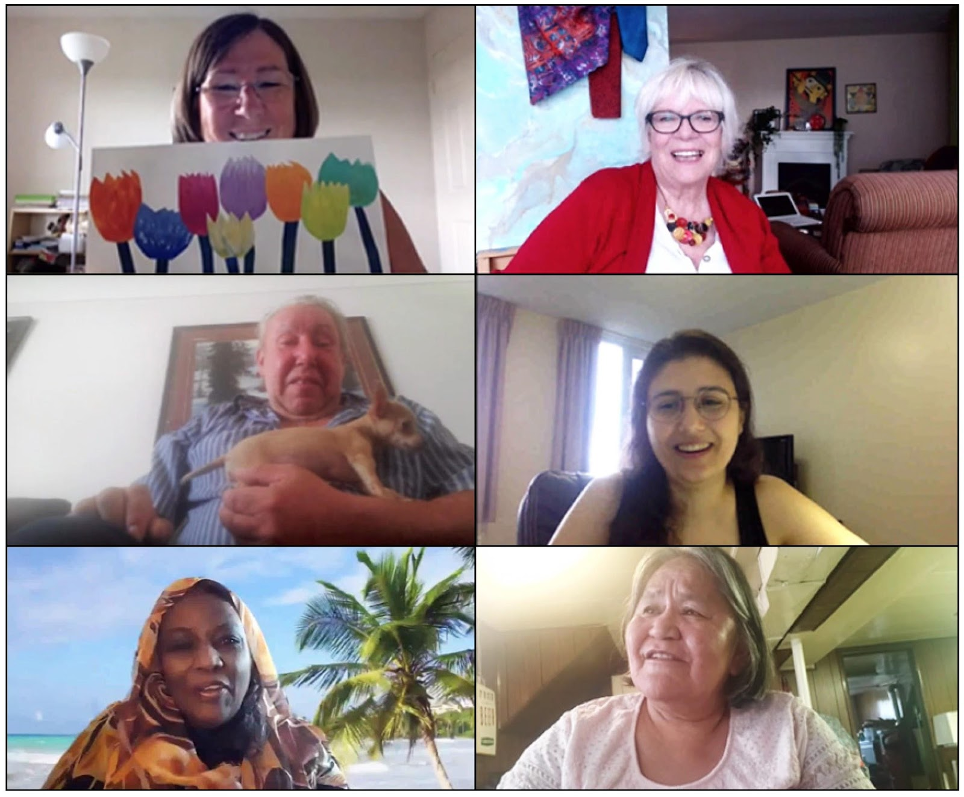
5 Key Findings
Creating a Digital Platform to
Engage Older Adults in Art Activities
Presented by Kathy Smith and Maggie Perquin, on behalf of Direct [Message],
a Community Based Inquiry Research Project focused on involving the greater areas of Hamilton, Guelph, and London, in Southwestern Ontario.
Notes:
Welcome and Thank you for joining us today. My name is Kathy Smith and I am an artist, instructor….. From London.
My name is Maggie Perquin and I am a retired teacher and choir director of the Forest City Singers in London.
We are both Community Consultants for the Direct message project (explain location etc quickly). We have spent the last 3 years engaging with older adults in the Hamilton, Guelph and London areas, to research how technology can help engage them in art activities in meaningful and successful ways.
Today we’d like to share 5 Key Findings from this research and present our idea for moving forward based on the findings of our research.

Slide 2
1.
Through research, we realized the power of the arts to engage and help to reduce isolation and loneliness in the older adult demographic.
How can technology facilitate engagement in the arts by older adults experiencing barriers to accessing digital services?
Notes:
The project began before COVID but had to pivot from in person gatherings to the virtual world. We created, then administered 3 interactive surveys with 33 older adults from Hamilton, London and Guelph. We asked them about the value of art in their lives and how they use and interact with technology to access art activities and events. (Show videos) That’s when we realized our first key finding. (read) We realized the difficulty older adults have using technology to continue to participate in their group activities. Art, in particular, has a unique set of barriers. We developed a goal to discover how technology can facilitate engagement in the arts by older adults experiencing barriers to accessing digital services.

Slide 3
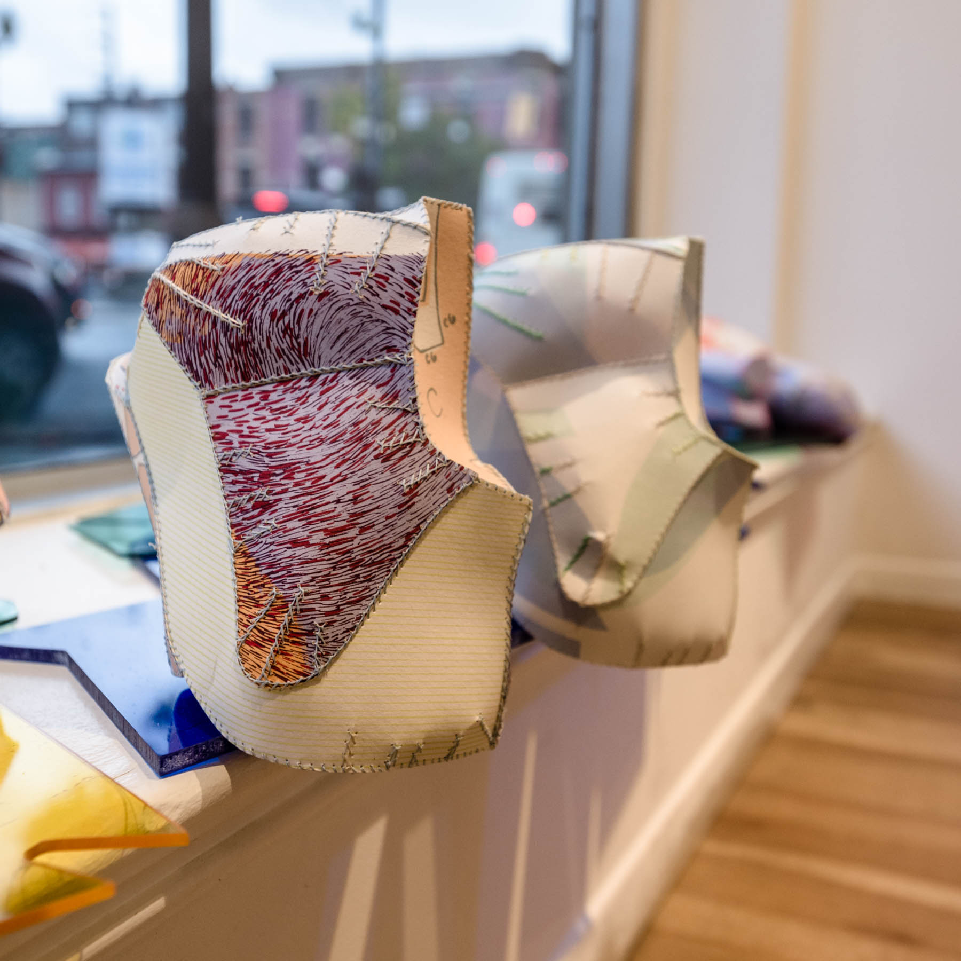
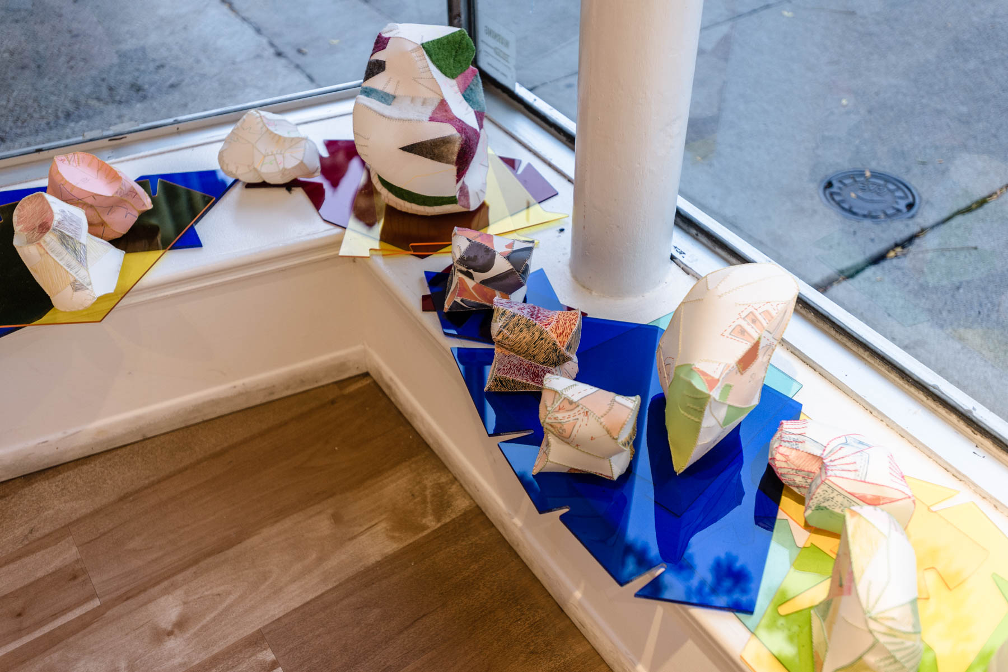
2.
Seniors wanted interactions that focus on
skill-building and building social connections.
These needs can be met through virtual galleries, user-to-user content sharing, curated resources on skill-building and arts access, and video-based interaction with pared-down set-up and control interfaces.
Notes:
The surveys also led us to our 2nd key finding. (read above) They were administered in the summer of 2021. The isolation of COVID particularly drew attention to the impact of the socializing that was missing in these activities. It became clear that watching tutorials on youtube wasn’t enough. People wanted to see and chat with other people while they were learning. (read bottom) Play Becky then gallery walk photos.

Slide 4
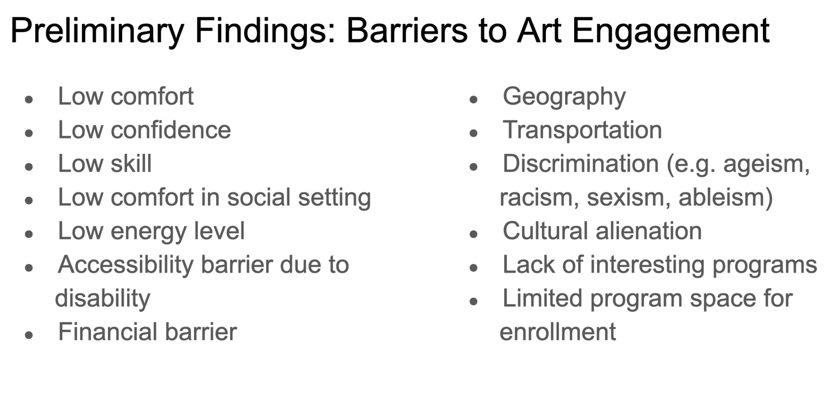
3.
Access to learning arts content needs to be simplified to meet the basic technological skills and equipment. A platform needs to be low tech, high engagement with ways to speak and connect with others while learning art skills.
Barriers to access need to be removed.
Notes:
Our 3rd key finding was (read it). To help with some of the technical frustrations, tutorials were created to help people use new devices or using their device for new purposes. These tutorials are available in Arabic as well as a portion of our demographic were Arabic speakers. We also created a prototype of a simple keyboard that would allow users to access activities easily on a dedicated website for art activities. In the summer of 2022, A new group of participants was gathered to test using this unique keyboard to make access to platforms and activities easier. That research showed that most folks had learned the skills necessary to use existing technology more successfully, but were excited to find a dedicated platform for art activities. However, we continue to work on creating technology that helps those with manual dexterity barriers.

Slide 5
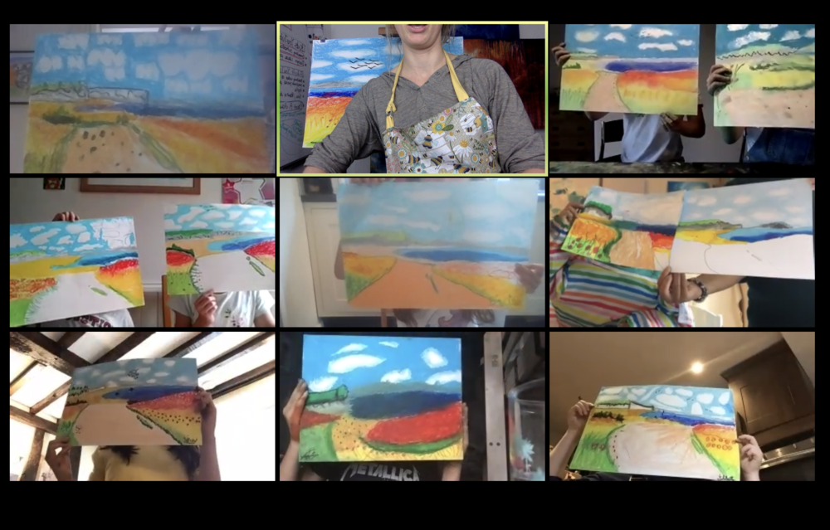
4.
Motivation is high for joining virtual workshops that provide social interaction and interest in learning arts content.
Notes:
After the first year of COVID we learned our 4th key finding. (read)Older adults became as technically proficient as they needed to be to join different groups or classes, mostly on zoom. Even as the world was opening up again, many older adults were hesitant to meet in person and preferred virtual gatherings. Weather also affects attendance in person as do barriers that many older adults face. These interviews also taught us of the many barriers that older adults face trying to work in the digital or virtual world, particularly in rural settings.

Slide 6
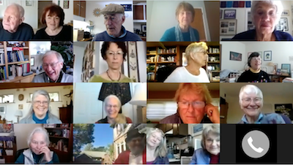
5.
Seniors look to the arts as ways of maintaining their well being with social contacts and learning that is fun and meaningful.
How can we work together with arts and culture organizations to house the content created and share it with service providers and have it accessible to agencies across the region?
Notes:
In our followup interviews, we realized our 5th key finding. Read It became crystal clear that older adults use art as a big part of maintaining their well being, when connected to social gatherings. We want to continue to offer programs, resources and activities that will contribute to the well being of our aging population. Read bottom.

Slide 7
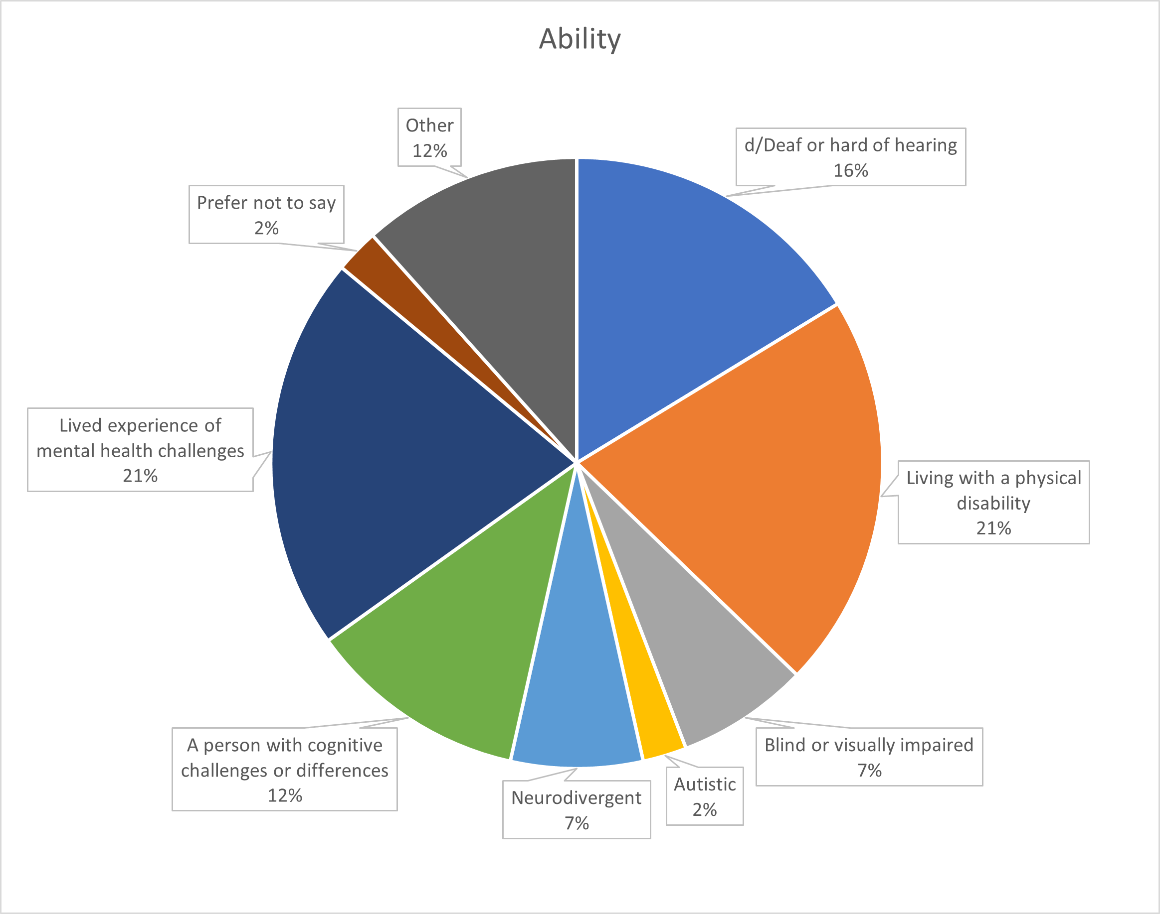
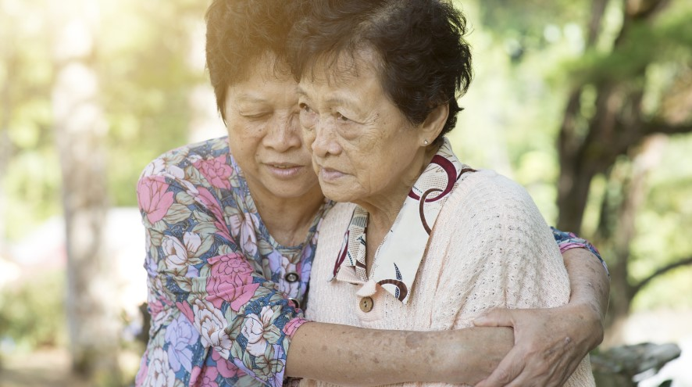
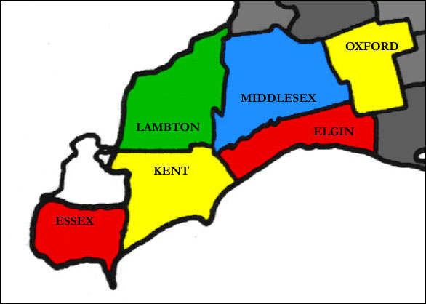
Acknowledging Barriers
Insights gleaned from this project made it obvious that there is a vital need among older community members for more digital creative programming, that is accessible and inclusive.
Notes:
We are aware of the barriers older adults face when accessing virtual activities. Our participants lived with varying disabilities, as well as financial, cultural, geographical (and other) barriers. When creating programs and options moving forward, these barriers must be considered in order to empower older adults to attend events that foster their well being and need for social connection. As part of the research we actively recruited folks who met criteria of facing barriers. However, we know that an inclusive opportunity is structured knowing “what is essential for some, is good for all”.

Slide 8
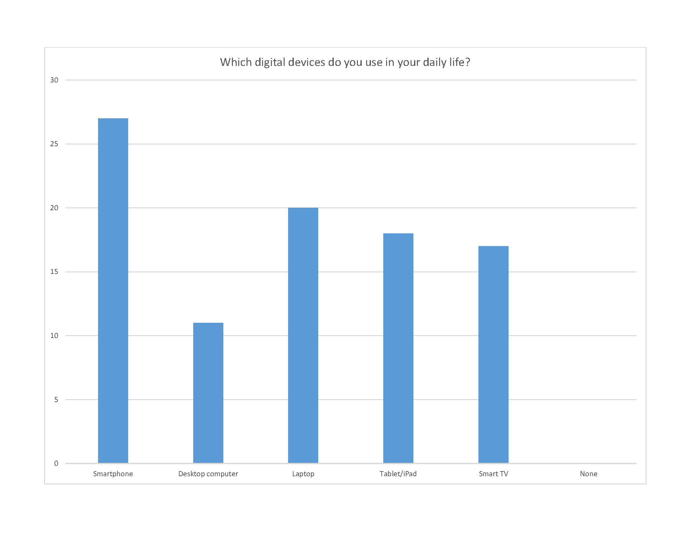
General Summary of Findings
Based on our preliminary findings, older adults in Southwestern Ontario overwhelmingly need/want digital options to participate in the arts.
Their motivation to join these activities spurs them to learn the technology necessary to join and create art.
Existing digital opportunities are limited, disappearing, and/or absent. Many older adults remain hesitant to be indoors in group settings.
Notes:
We want to share these findings with you with the hopes that this information will help you continue to create inclusive digital art and culture programs to serve the older adults in Southwestern Ontario. As you can see, most use some form of digital device on a daily basis, and will learn the skills they need in order to participate in meaningful art activities. To make the findings available we have created a website for you to access.

Slide 9
Why Seniors Art Link?
We have created a website for agencies and groups who provide programming for older adults, to access meaningful art activities that provide social connections as well as skill building opportunities.
It is a resource location to store the documents and reports of this research project.
Will store the pre-recorded workshop videos, tutorials, artist talks, gallery walk, art crawl videos in full length
It will house a list of agencies and businesses that offer free programming in the arts for seniors.
Our desire for the future is to focus on developing sustainable virtual options that can promote older adults’ engagement with the arts and increase social interactions.
Notes:
Using this information, we wish are moving forward and creating Seniors Art Link. This will be a website created for agencies, service providers, artists, researchers, program developers who provide services for older adults. All the videos and images shared with you today, are stored here in their entirety. All the documents and reports created as part of the research project will be stored here for people to use as references or supports for further work developing digital programming for older adults. We will populate it with lists of agencies and businesses offering free programming in the arts for seniors. Every effort will be made to find accessible, inclusive programs and activities.
Our desire for future development of Seniors Art Link is to have it be collaborative with artists, service providers, museums, galleries etc, to build a free set of resources and activities to service the older adult population. We will continue to add workshops by artists in various media for seniors to access. A long term goal of Seniors Art Link is to provide open studio time.

Slide 10
Feedback and Q & A
Would this be a platform your organization would find beneficial?
Do you see yourself contributing content to the platform for others to use and share?
What are you looking for in the future to boost your digital programming?
Notes:
Run the Q & A
Note the feedback

Slide 11
Feedback
Would this be a platform your organization would find beneficial?
Do you see yourself contributing content to the platform for others to use and share?
What are you looking for in the future to boost your digital programming?

